Slide 1

Vel Tech Rangarajan Dr. Sagunthala R&D Institute of Science and Technology
School of Computing
Department of Computer Science and Engineering
10211CS224 / FULL STACK APPLICATION DEVELOPMENT (JAVA)
PROJECT REVIEW : MILESTONE PROJECT – 2
Date: 20-04-2026
JOB PORTAL MANAGEMENT SYSTEM
SDG: 9 – Industry, Innovation and Infrastructure
Presented By:
C.SURYA SRINIDHI – VTU24957 – 23UECS0691
Courses Handling Faculty:
Dr. S. Hemamalini – Assistant Professor(Senior Grade)-M.E,Ph.D

Slide 2
.
INTRODUCTION
1
• A Job Portal Management System is a web-based application designed to connect job seekers and employers on a single platform.
• It provides an easy-to-use interface where users can search, view, and apply for jobs online from anywhere.
• Employers can post job vacancies with details such as skills, experience, and salary, and manage applicants efficiently.
• The system helps students and job seekers create professional profiles and upload their resumes for better visibility.
• It reduces the manual effort involved in traditional job searching and recruitment processes.
• Users can filter and search jobs based on category, location, skills, and experience level.
• The system maintains application status and provides real-time notifications to users.
• It enhances communication between job seekers and employers through automated updates and alerts.
• The system ensures secure login with role-based access control (Student, Employer, Admin).
• Overall, it simplifies, organizes, and digitalizes the recruitment process for better efficiency.
2
3
4
5
6
7
8
9

Slide 3
PROBLEM STATEMENT
1
• Job recruitment processes are often manual, unorganized, and time-consuming, leading to delays in hiring.
• Job seekers need to visit multiple platforms and websites to find suitable job opportunities, which is inefficient.
• There is no proper system available to track job applications and monitor their current status.
• Employers struggle to manage and organize large numbers of applicants effectively.
• Lack of a centralized database leads to data mismanagement and difficulty in accessing information.
• It is difficult to filter candidates based on required skills, qualifications, and experience.
• There is no proper communication system between job seekers and employers for updates and notifications.
• There is a high risk of duplicate applications or missing application records in manual systems.
2
3
4
5
6
7
8
9

Slide 4
OBJECTIVE(S)
1
• To develop a web-based Job Portal Management System that connects job seekers and employers on a single platform.
• To simplify and automate the recruitment process with features like job posting, job search, application tracking, and secure access.
2
3
4
5
6
7
8
9

Slide 5
PROPOSED SYSTEM
1
• The system is a web-based Job Portal Management System.
• It allows users to register and log in securely.
• Job seekers can create profiles and upload resumes.
• Users can search and filter jobs based on skills and location.
• Job seekers can apply for jobs and track their application status.
• Employers can post, edit, and delete job vacancies.
• Employers can view applicants and shortlist or reject candidates.
• The system stores all data in a centralized database and provides real-time updates.
2
3
4
5
6
7
8
9

Slide 6
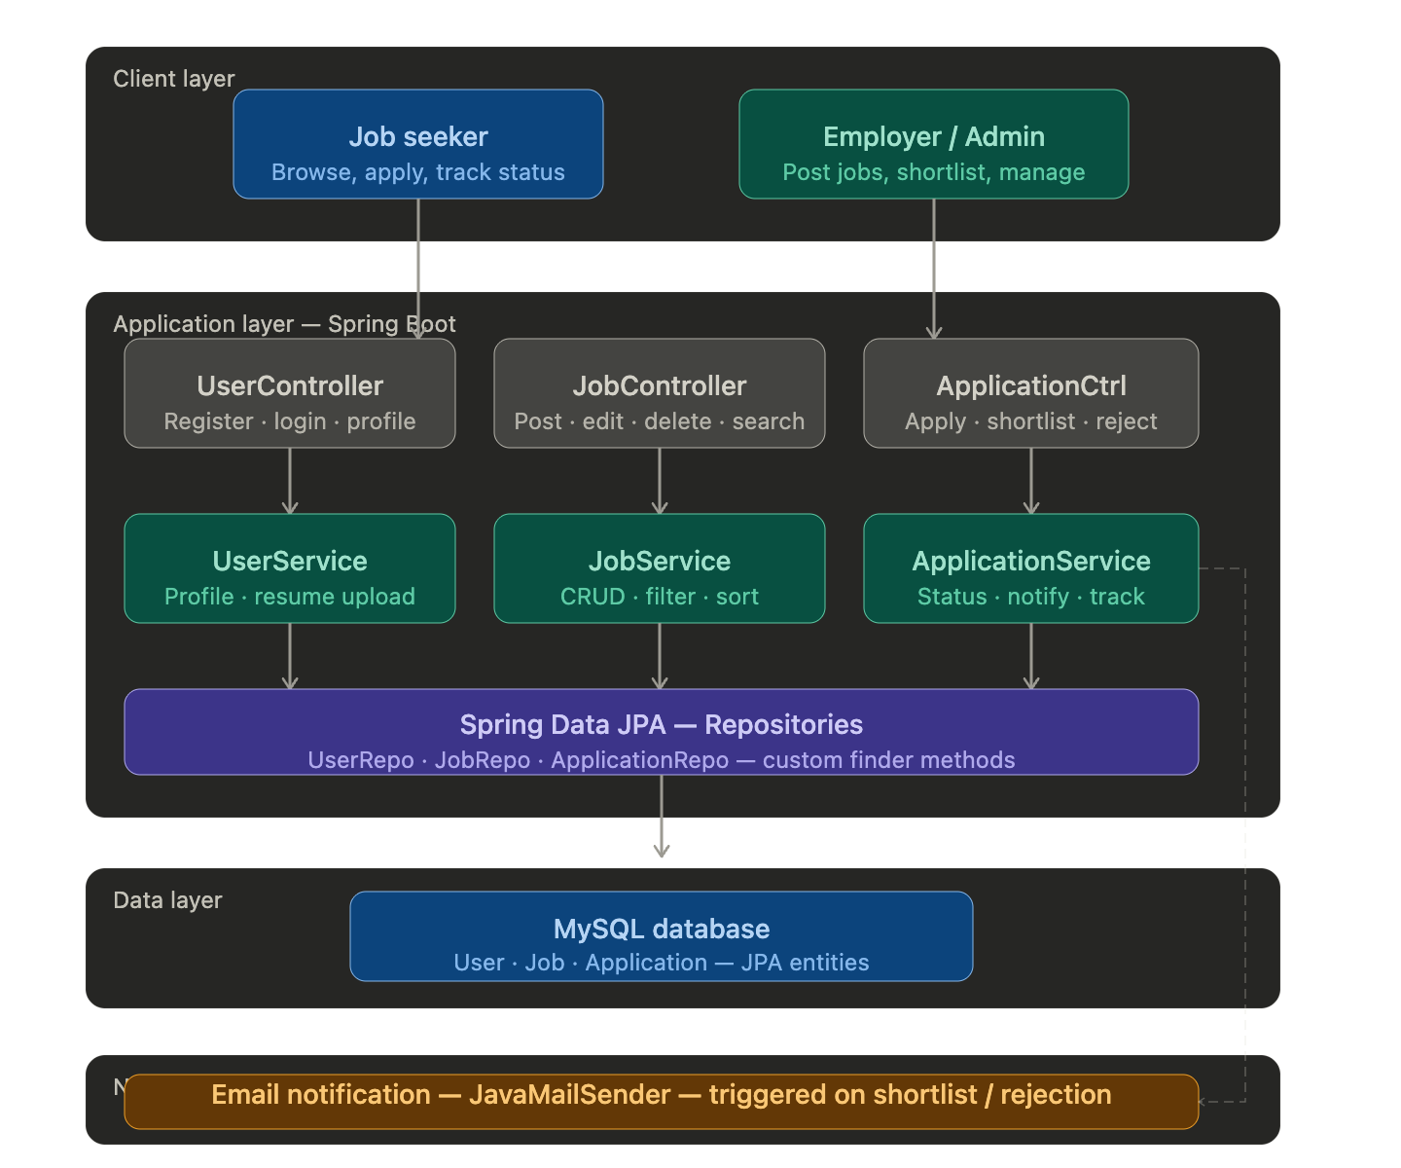
PROPOSED SYSTEM ARCHITECTURE
1
2
3
4
5
6
7
8
9

Slide 7
PROPOSED SYSTEM ARCHITECTURE
Input: User registration details, login credentials, job postings, resume uploads, and job applications.
Processing: User authentication, job search and filtering, application submission, validation, and status tracking.
Database: Stores user details, employer details, job listings, applications, and resume files.
Output: Job listings, application status updates, notifications, user dashboard, and employer reports.
1
2
3
4
5
6
7
8
9

Slide 8
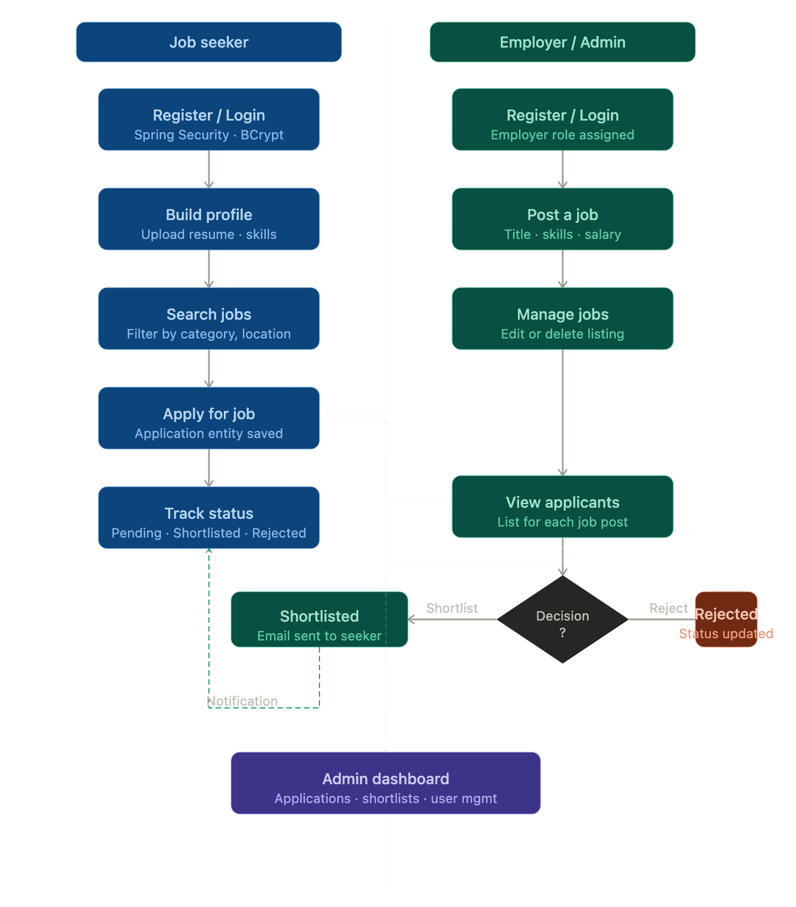
WORKFLOW
1
2
3
4
5
6
7
8
9

Slide 9
TECHNLOGIES USED
1
Frontend:
- HTML, CSS, Thymeleaf
Backend:
- Java, Spring Boot, Spring MVC
Database:
- MySQL
Tools:
- Visual Studio Code, MySQL Workbench, Spring Initializer
Hardware/Software Requirements:
- System with minimum 4GB RAM
- JDK 8 or above
- Spring Boot
- MySQL Server
- Web Browser (Chrome)
2
3
4
5
6
7
8
9

Slide 10
MODULE DESCRIPTION
Module 1: Job Seeker (User) Module Handles user registration, login, profile creation, resume upload, job search, and applying for jobs.
Module 2: Employer Module Allows employer login, posting job vacancies, managing job listings, and viewing applicants. Module 3: Job Management Module Manages job details, job updates, filtering, searching, and deletion of job postings.
Module 4: Application Management Module Handles job applications, application tracking, status updates, and shortlist/reject process.
Module 5: Notification Module Generates email notifications and alerts for job applications, status updates, and job postings.
1
2
3
4
5
6
7
8
9

Slide 11
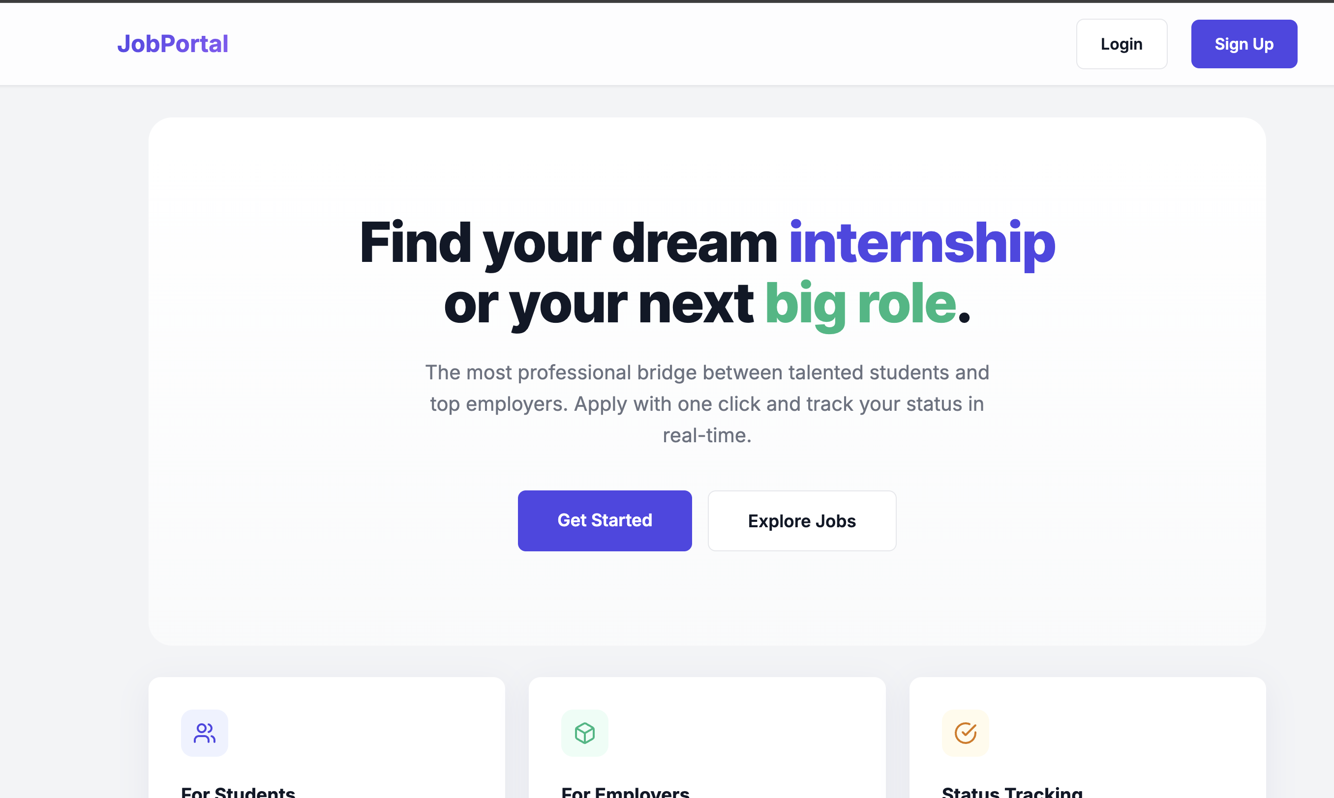
IMPLEMENTATION SCREENSHOTS
HOME PAGE
1
2
3
4
5
6
7
8
9
This is the main entry page of the Job Portal where users can navigate to login or sign up.
It provides an overview of the platform and allows users to explore job opportunities or get started.

Slide 12
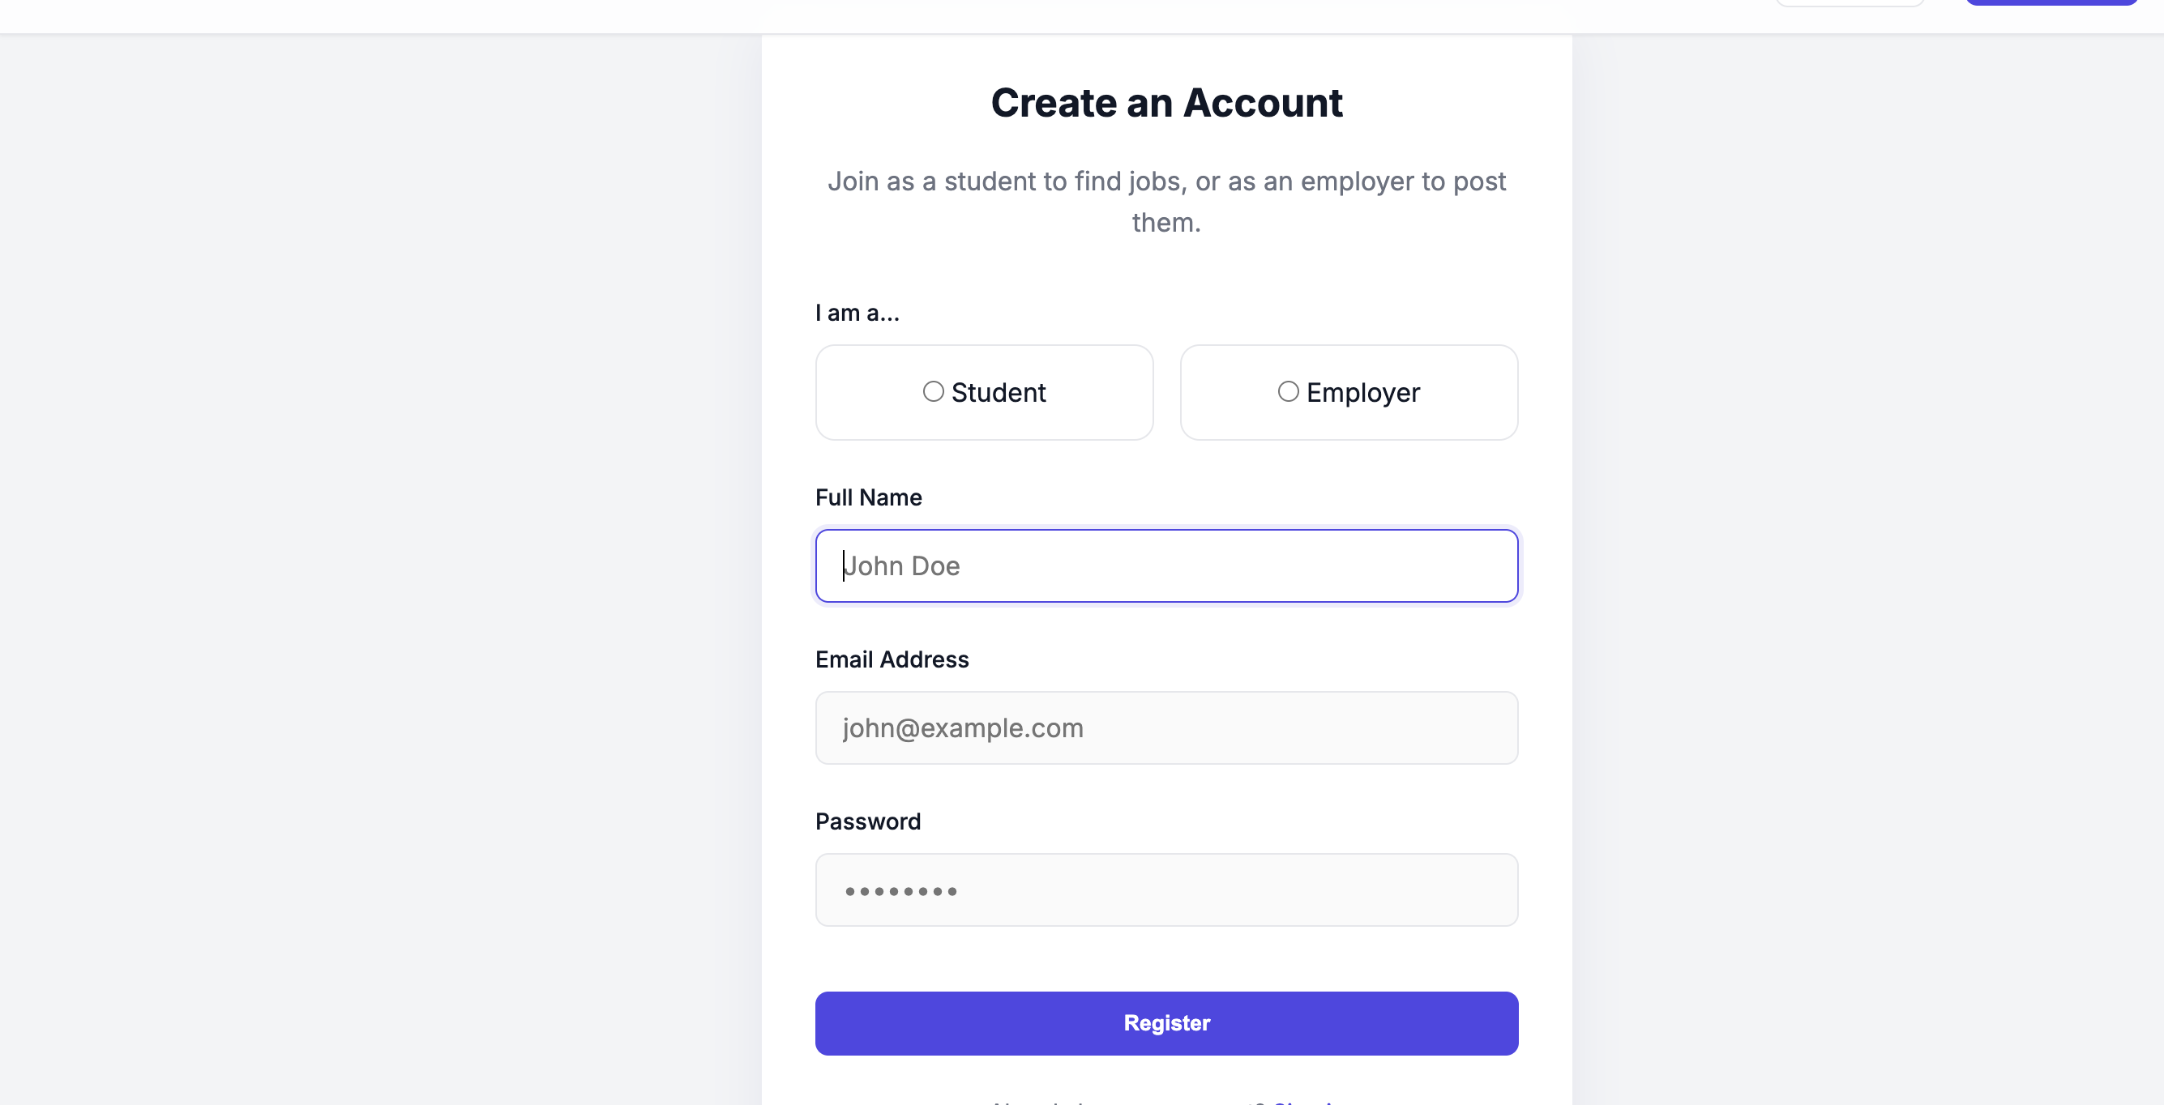
IMPLEMENTATION SCREENSHOTS
REGISTRATION PAGE
1
2
3
4
5
6
7
8(A)
• This page allows users or employer to create a new account by entering details like name, email, and password.
• It ensures secure user or employer registration and provides access to the job portal features after successful signup.
9

Slide 13
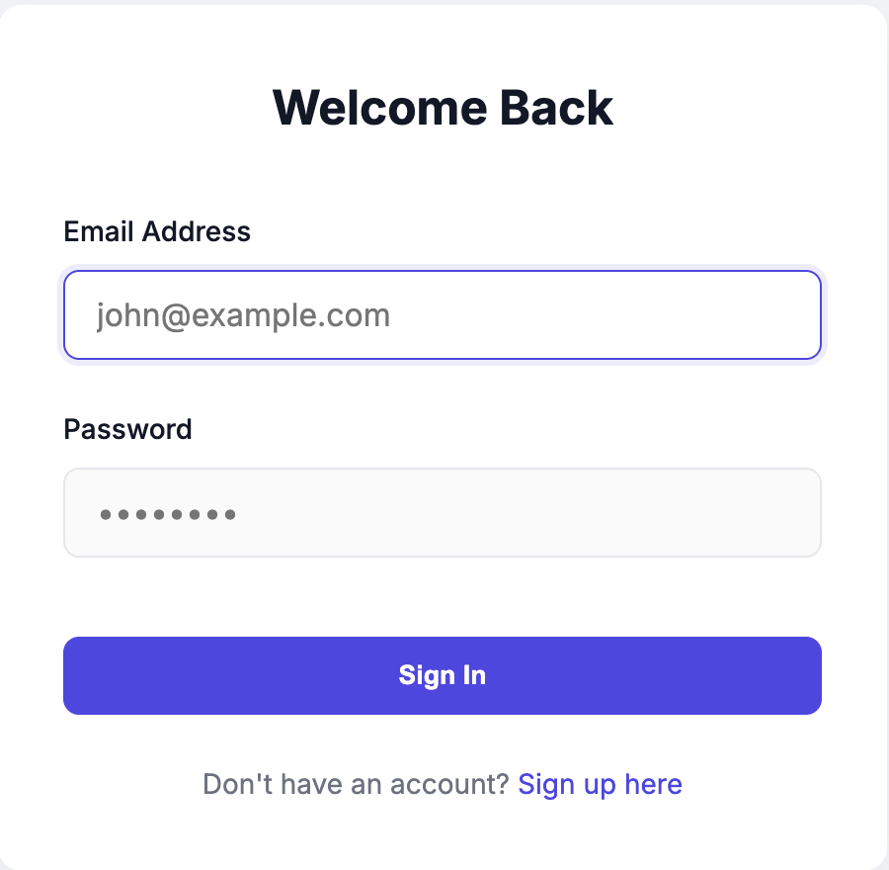
IMPLEMENTATION SCREENSHOTS
LOGIN PAGE
1
2
3
4
5
6
7
8(B)
• This page allows registered users or employers to log in using their email and password.
• It provides secure access to the system and redirects users to their respective dashboards after successful login.
9

Slide 14
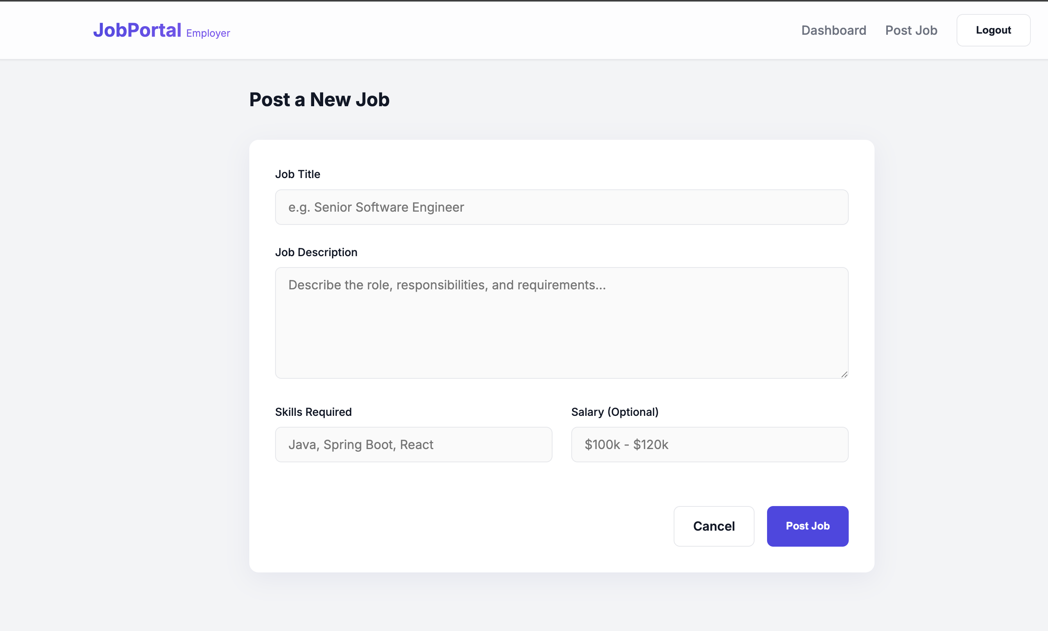
IMPLEMENTATION SCREENSHOTS
EMPLOYER JOB POSTING PAGE
1
2
3
4
5
6
7
8(C)
• This page allows employers to create and post new job vacancies by entering details like title, description, skills, and salary.
• It helps employers manage job listings and attract suitable candidates for recruitment.
9

Slide 15
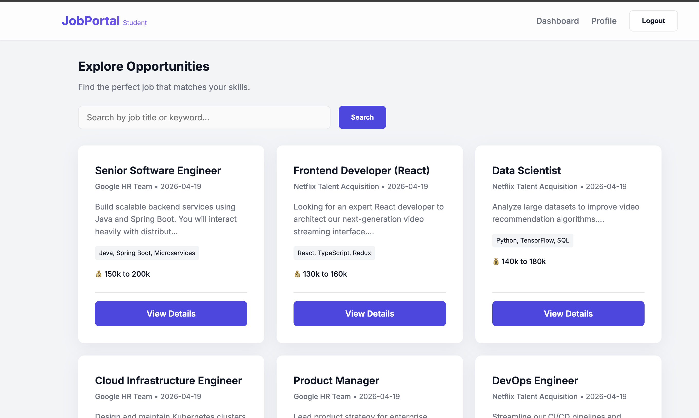
IMPLEMENTATION SCREENSHOTS
JOB LISTINGS PAGE
1
2
3
4
5
6
7
8(D)
• This page displays available job opportunities with details like job title, company, skills, and salary.
• It allows users to search jobs and view detailed information before applying.
9

Slide 16
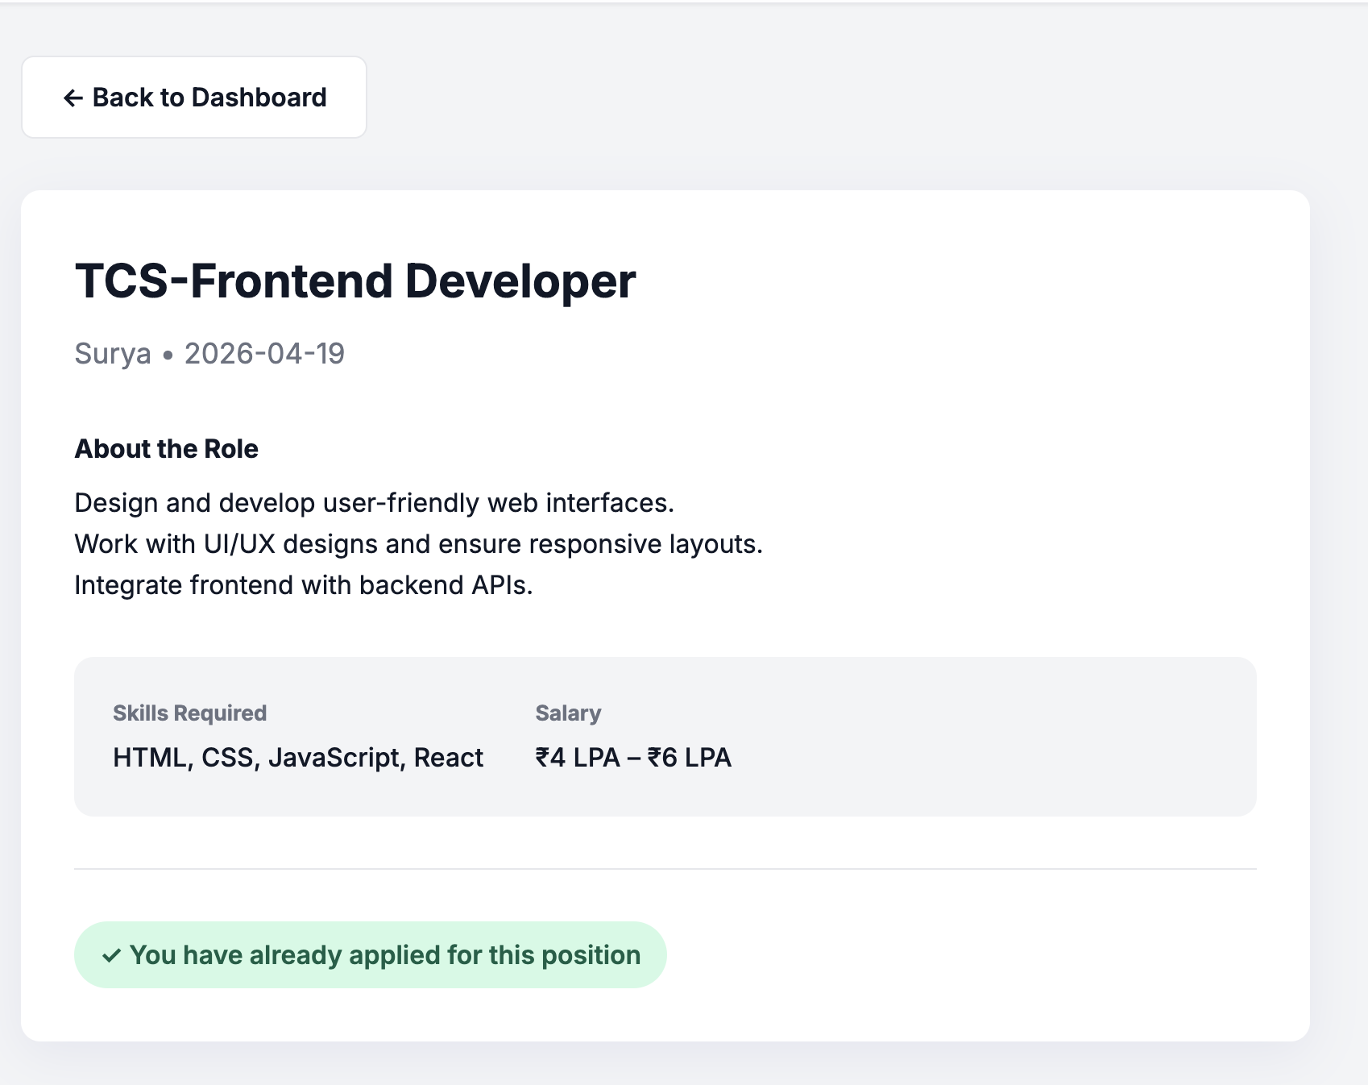
IMPLEMENTATION SCREENSHOTS
JOB DETAILS PAGE
1
2
3
4
5
6
7
8(E)
• This page displays complete information about a selected job including description, required skills, and salary.
• It allows users to view detailed job information and track their application status.
9

Slide 17
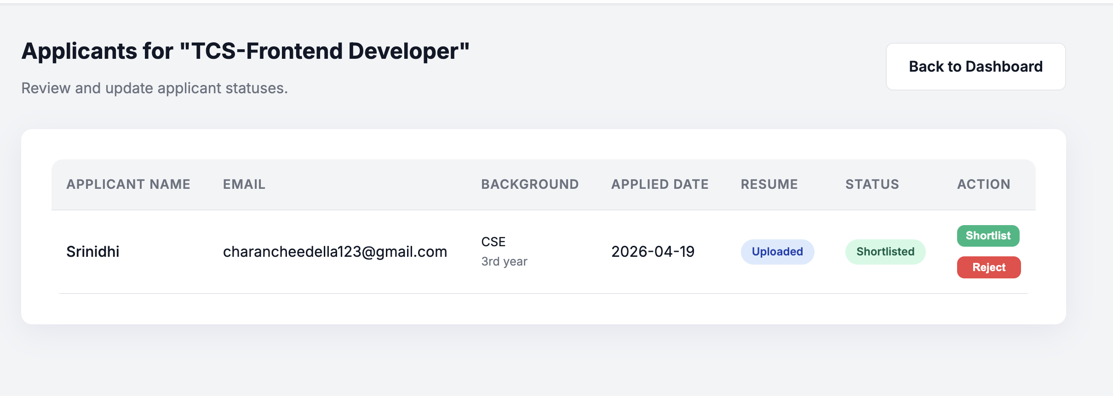
IMPLEMENTATION SCREENSHOTS
APPLICANT MANAGEMENT PAGE
1
2
3
4
5
6
7
8(F)
• This page allows employers to view all applicants for a specific job along with details like name, email, background, and resume.
• It enables employers to update application status by shortlisting or rejecting candidates.
9

Slide 18
IMPLEMENTATION SCREENSHOTS
APPLICANT MANAGEMENT PAGE
1
2
3
4
5
6
7
8(G)
• This page allows employers to view all applicants for a specific job along with details like name, email, background, and resume.
• It enables employers to update application status by shortlisting or rejecting candidates.
9

Slide 19
ADVANTAGES & LIMITATIONS
1
ADVANTAGES:
• Reduces manual recruitment process and saves time. • Easy job search and application for users. • Employers can manage job postings and applicants efficiently. • Provides real-time application tracking and updates. • Centralized database ensures organized data management.
Limitations:
• Requires internet and system availability. • Basic security (can be improved with advanced encryption). • Depends on server availability (Spring Boot/MySQL).
2
3
4
5
6
7
8
9

Slide 20
Thank you

